Slide 1
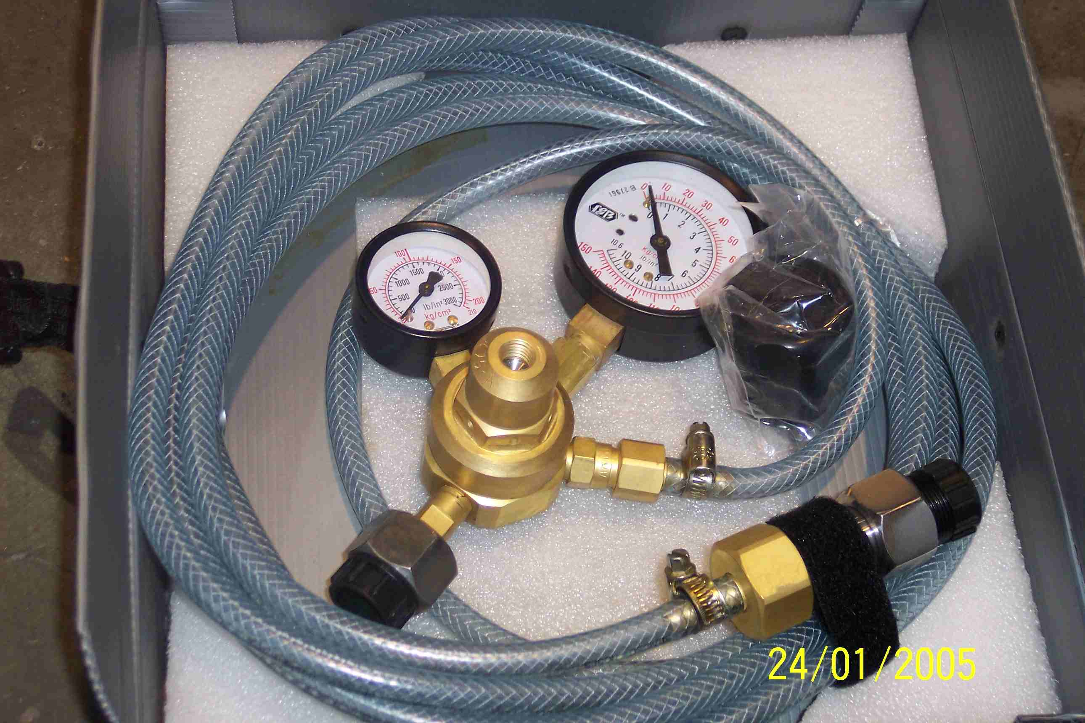
SIEMENS
HVCB SPARES
SF6 Gas Filling Device
S4799095001

